Slide 1


NFC TECHNOLOGY
Smartdev Mobile Team
Presenter: Hoang Ngoc Tan

Slide 2

Contents
Part 1
NFC Basic
Part 2
NFC Protocol (APDU)
Part 3
Read an NFC Card
Part 4
Simulate an NFC Card

Slide 3
Contents
Part 1
NFC Basic
Part 2
NFC Protocol (APDU)
Part 3
Read an NFC Card
Part 4
Simulate an NFC Card

Slide 4
NFC Basic
04
03
Basic Concepts
Usage
Some concepts
The usage of NFC
01
05
Defination
02
What is NFC technology?
NFC Detection
Benefits
How to detect if device has NFC available?
The benefit of NFC

Slide 5
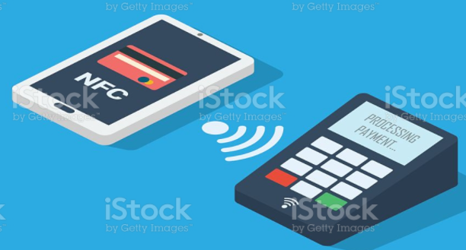
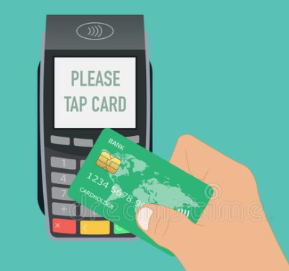
1. What is NFC?
Communication mode
Near Field Communication
short range high frequency wireless communicaton technology
Card Emulation
Enables NFC-enabled devices such as smartphones to act like smart cards, allowing users to perform transactions such as payment or ticketing
Card Reader/ Writer
Enables NFC-enabled devices to read information stored on inexpensive NFC tags embedded in labels or smart posters
peer-to-peer
Enables two NFC-enabled devices to communicate with each other to exchange information
Radio Communication
established by touching the two phones or keeping them in a proximity of a few centimeters (up to 10 cm)
Active communication
(2 powered NFC devices)
Communication Type
Passive communication
(1 powered NFC device & 1 non (self) powered device)

Slide 6





2. Benefit of NFC?
Convenience
Security
Short range communication
(hard to stolent the transfering data)
SmartCard using Secure Element
(a tamper resistant smart card chip capable of running smart card applications (called applets or cardlets) with a certain level of security and features)

Slide 7

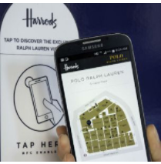
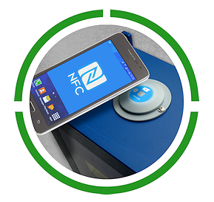

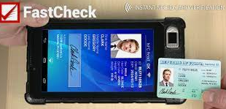
3. NFC Usage
Mobile transactions
Access Information
Connect Electronic Devices
Contactless payment
Control IOT device
Advertisements
Mobile
ticketing
Identification Cards

Slide 8
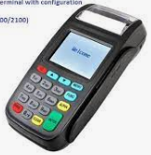
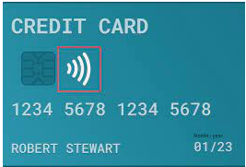
4. Basic concepts
Secure element
APDU command
Applet
ndef record
NDEF message
NFC Tags
NDEF
NFC Data Exchange Format
APDU
Application Protocol data unit

Slide 9
4. Basic concepts
NFC TAGS
passive data stores
- contain data (betweens 96 and 8,192 bytes).
- are read-only in normal use, but may be rewritable
- can be read, and under some circumstances written to, by an NFC device.
secure personal data storage
- includes debit or credit card information, loyalty program data, personal identification numbers (PINs), contacts.
- NFC tags can be custom-encoded by their manufacturers or use the industry specifications.

Slide 10
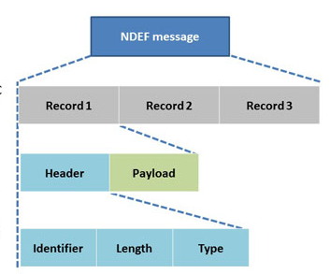
4. Basic concepts
NDEF – NFC Data Exchange Format
NDEF messages provide a standardized method for a reader to communicate with an NFC device
contains multiple records

Slide 11
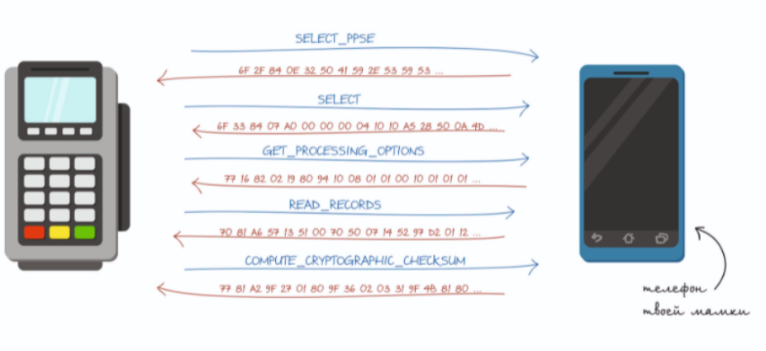
4. Basic concepts
APDU – Application Protocol Data Unit
The communication unit between a smart card reader and a smart card
The structure of the APDU is defined by ISO/IEC 7816-4

Slide 12
4. Basic concepts
Applet – Application Protocol Data Unit
The communication unit between a smart card reader and a smart card
The structure of the APDU is defined by ISO/IEC 7816-4

Slide 13
Contents
Part 1
NFC Basic
Part 2
NFC Protocol (APDU)
Part 3
Read an NFC Card
Part 4
Simulate an NFC Card

Slide 14
APDU
Command APDU
00 A4 04 00 0E32 50 41 59 2E 53 59 53 2E 44 44 46 30 31 00
Response APDU
6F 39 84 0E 32 50 41 59 2E 53 59 53 2E 44 44 46 30 31 A5 27 BF 0C 24 61 22 4F 07 A0 00 00 00 03 10 10 50 10 56 43 42 20 56 49 53 41 20 50 41 59 57 41 56 45 87 01 01 9F 2A 01 03 90 00

Slide 15
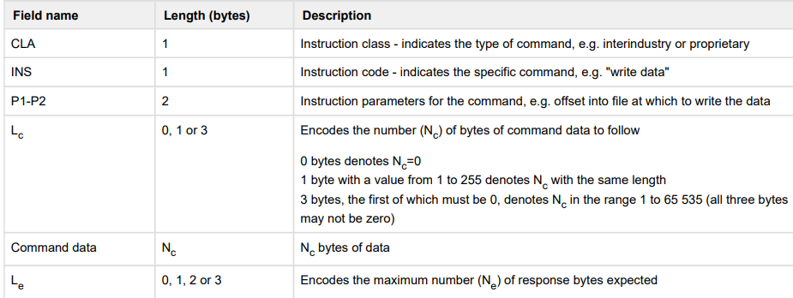
APDU
Command APDU
00 A4 04 00 0E32 50 41 59 2E 53 59 53 2E 44 44 46 30 31 00
Smart Cart Commands & Response codes reference:
http://www.wrankl.de/SCTables/SCTables.html

Slide 16
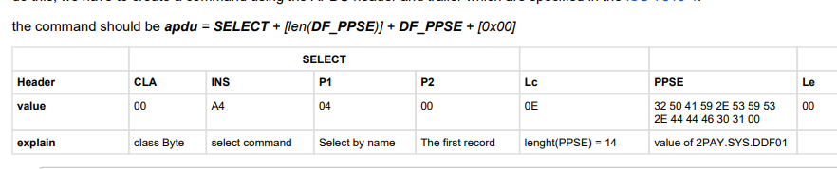
APDU
Command APDU
Select PPSE command
00 A4 04 00 0E32 50 41 59 2E 53 59 53 2E 44 44 46 30 31 00

Slide 17
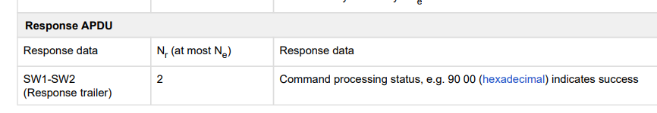
APDU
Command APDU

Slide 18
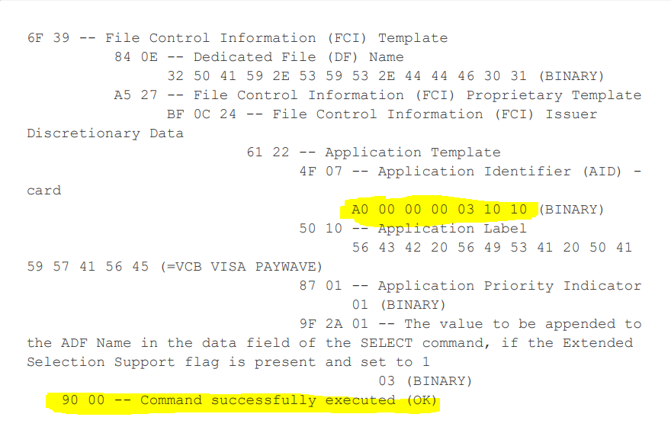
APDU
Command APDU
Select PPSE response explanation

Slide 19
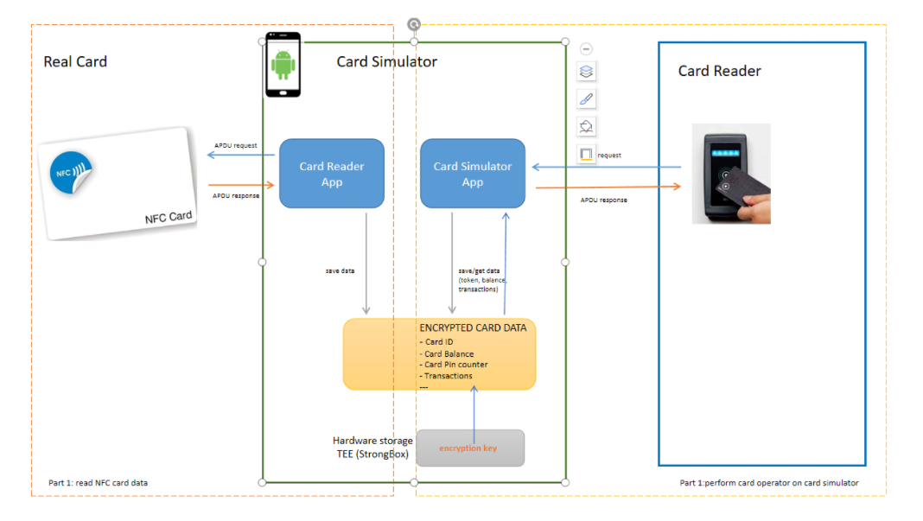

Slide 20
Contents
Part 1
NFC Basic
Part 2
NFC Protocol (APDU)
Part 3
Read an NFC Card
Part 4
Simulate an NFC Card

Slide 21
Read an NFC Card
Build a Card Reader
1/ Request NFC access
2/ Filter for NFC intent (optional)
3/ Implement NfcAdapter
4/ Process the APDU command

Slide 22
The NFC <uses-permission> element to access the NFC hardware
Build a Card Reader
1. Request NFC access
Permission to access the NFC hardware
<uses-permission android:name="android.permission.NFC"/>
Tell Google Play that only show your app for devices that have NFC hardware
<uses-feature android:name="android.hardware.nfc" android:required="true"/>

Slide 23
The NFC <uses-permission> element to access the NFC hardware
Build a Card Reader
2. Filter for NFC intent (optional)
Register a filter
<intent-filter> <action android:name="android.nfc.action.TECH_DISCOVERED"/> </intent-filter> <meta-data android:name="android.nfc.action.TECH_DISCOVERED" android:resource="@xml/nfc_tech_filter" />
<?xml version="1.0" encoding="utf-8"?> <resources xmlns:xliff="urn:oasis:names:tc:xliff:document:1.2"> <tech-list> <tech>android.nfc.tech.IsoDep</tech> </tech-list> <tech-list> <tech>android.nfc.tech.NfcA</tech> </tech-list> <tech-list> <tech>android.nfc.tech.NfcB</tech> </tech-list> </resources>
Specify the kind of tech that
our application want to handle

Slide 24
The NFC <uses-permission> element to access the NFC hardware
Build a Card Reader
3. Implement NFC Adapter
Initiate an NfcAdapter
nfcAdapter = NfcAdapter.getDefaultAdapter(this)
nfcAdapter?.enableReaderMode(this, this, NfcAdapter.FLAG_READER_NFC_A or NfcAdapter.FLAG_READER_SKIP_NDEF_CHECK, null)
Enable adapter Reader mode
override fun onTagDiscovered(tag: Tag?) { val isoDep = IsoDep.get(tag) isoDep.connect() processAPDUCommands(isoDep) isoDep.close() }
Implement Reader callback

Slide 25
The NFC <uses-permission> element to access the NFC hardware
Build a Card Reader
4. Process the APDU command to read Card data
val apduCommandMap: Map<String, String> = mapOf( "SELECT_AID" to "00A4040007A000000003101000", "GET_PROCESSING_OPTIONAL" to "80A80000238321278xxxxxx00", "GET_PIN_TRY_COUNTER" to "80CA9F1700", "GET_TRANSACTION_COUNTER" to "80CA9F3600" )
Defines Apdu commands
Executes the commands
fun executeApduCommand(apduCommandString: String, isoDep: IsoDep): ByteArray { return isoDep.transceive(TypeConvertor.hexStringToByteArray(apduCommandString)) }

Slide 26
Contents
Part 1
NFC Basic
Part 2
NFC Protocol (APDU)
Part 3
Read an NFC Card
Part 4
Simulate an NFC Card

Slide 27
Simulate an NFC Card
1/ Host-base card Emulation
2/ Build a Smartcard simulator

Slide 28
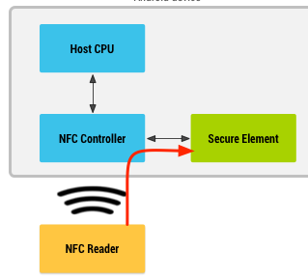
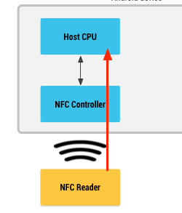
Simulate an NFC Card
1. Host-base card Emulation
Card emulation with a secure element
Host-based card emulation
data is routed directly to the secure element
data is routed directly to the host CPU
no Android application is involved in the transaction

Slide 29
Simulate an NFC Card
1. Host-base card Emulation
Requires
Android 4.4 or higher
ISO-DEP specification (based on ISO/IEC 14443-4)
Nfc-Type: Nfc-A (on top), Nfc-B (optional)
Application Protocol Data Units (APDUs) as defined in the ISO/IEC 7816-4 specification

Slide 30
Simulate an NFC Card
2. Build a Smartcart Simulator
Implement an HCE service
Check for HCE support
Declare a Host apdu service
Specify the Aid filter
Handle process Command apdu received from the Terminal

Slide 31
Simulate an NFC Card
2. Build a Smartcart Simulator
Check for HCE support
declare that your app uses the HCE feature, and whether it is required for the app to function or not
<uses-feature android:name="android.hardware.nfc.hce" android:required="true"/>

Slide 32
Simulate an NFC Card
2. Build a Smartcart Simulator
Declare a Host apdu service
service android:name=".service.HostCardEmulatorService" android:exported="true" android:permission="android.permission.BIND_NFC_SERVICE"> <intent-filter> <action android:name="android.nfc.cardemulation.action.HOST_APDU_SERVICE"/> </intent-filter> <meta-data android:name="android.nfc.cardemulation.host_apdu_service" android:resource="@xml/apduservice"/> </service>

Slide 33
Simulate an NFC Card
2. Build a Smartcart Simulator
Specify the Aid filter
<host-apdu-service xmlns:android="http://schemas.android.com/apk/res/android" android:description="@string/servicedesc" android:requireDeviceUnlock="false"> <aid-group android:description="@string/aiddescription" android:category="other"> <aid-filter android:name="A0000000031010"/> <!-- Indicate that the service will only handle the request to the aid VISA DEBIT = A0000000031010--> </aid-group> </host-apdu-service>

Slide 34
Simulate an NFC Card
2. Build a Smartcart Simulator
Handle process Command apdu received from the Terminal
class HostCardEmulatorService: HostApduService() { override fun processCommandApdu(commandApdu: ByteArray?, p1: Bundle?): ByteArray { val commandApduStr = TypeConvertor.toHex(commandApdu)
handleApduRequest() } override fun onDeactivated(reason: Int) { Log.d(TAG, "HostCardEmulatorService Deactivated: " + reason) } }

Slide 35
Thank all !

